Slide 1
Traumatic Brain Injury (TBI)
Team 10
Spreading awareness of TBI

Slide 2
Table of contents
01
02
03
04
05
Introduction
Symptoms
Risks about TBI
Background of the TBI
Symptoms of TBI
Relevant data to show more details about TBI
TBI in Military
Effective care
Details about TBI in Military
Effective care to handle TBI cases

Slide 3
01
Introduction
TBI

Slide 4
Traumatic Brain Injury
Brain Injury Awareness Month, observed each March, was established 3 decades ago to educate the public about the incidence of brain injury and the needs of persons with brain injuries and their families.
Traumatic Brain Injury (TBI) is caused by a bump, blow, or jolt to the head, or penetrating head injury which can lead to short- or long-term changes affecting thinking, sensation, language, or emotion.
The goal of this project is to spread awareness for just how common TBIs are - both in civilian and military populations.

Slide 5
What are TBI Symptoms?
Physical Symptoms
Cognitive Symptoms
Seizures:
Headaches, dizziness, nausea, sensitivity to light/noise, vision changes.
Memory problems, difficulty concentrating, confusion, speech issues
Some cases may lead to seizures.
Sensory & Motor Symptoms
Emotional & Behavioral Symptoms
Loss of taste/smell, hearing problems, numbness, coordination issues.
Mood swings, irritability, anxiety, sleep disturbances, impulsivity.

Slide 6
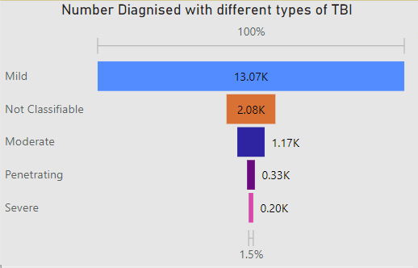
What are the severity levels of TBI?
There are different Levels of severity based off of loss of consciousness, length of memory loss and responsiveness after the injury.
Mild TBI —commonly called concussions—are those that usually result in no persistent symptoms.
Moderate and Penetrative have cognitive or behavioral risks eg prolonged period of confusion
Most severe TBI can result in patients having significant impairment of cognitive or physical abilities i.e remaining in a coma or vegetative state

Slide 7
Effects of TBI
Cognitive Impact:
Memory Loss, Attention Issues: Impairments affecting daily tasks and focus.
Physical Challenges:
Motor Skills, Fatigue: Coordination problems, persistent tiredness affecting activities.
Emotional and Behavioral Changes:
Mood Swings, Impulsivity: Emotional instability, difficulty controlling impulses.
Sensory Disturbances:
Sensitivity, Vision/Hearing Issues: Heightened senses, blurred vision, ringing in ears.
Communication Challenges:
Speech Problems, Social Difficulties: Difficulty speaking, challenges in social interactions.
Long-Term Consequences:
Chronic Health Issues, Cognitive Decline: Increased risk of epilepsy, cognitive decline, and neurodegenerative conditions.

Slide 8
Causes of Traumatic Brain Injury
Unintentional falls are the leading cause of Traumatic Brain Injury
Injury Mechanism | Total number
Unintentionally struck by or against an object | 980
Assault | 9690
Unintentional Falls | 96568
Motor Vehicle Crashes | 931
Other unintentional injury, mechanism unspecified | 859

Slide 9
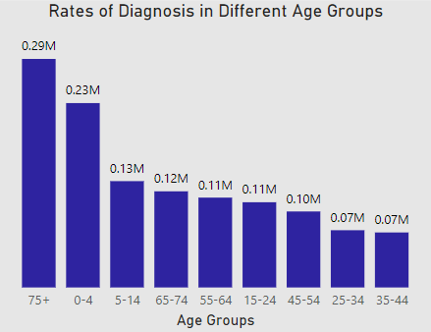
Which Age Groups are at Risk?
Adults 75 years and older and Children aged 0 - 4 years are most likely to sustain a TBI
People aged 35 - 44 have lower rates of diagnosis of TBI as compared to other age groups
Increased childhood activities and participation in sports contribute to more accidents, including TBIs, among young individuals.
Reduced balance and mobility in the elderly lead to a higher risk of falls, a common cause of TBIs in this age group

Slide 10
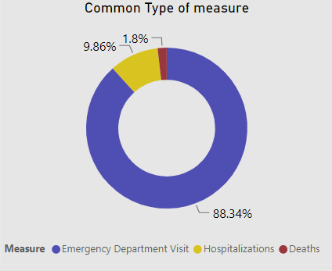
Traumatic Brain Injury (TBI) Incidence
88.34% people with TBI are most likely to be treated in an emergency department
9.8% of people sustain a TBI severe enough to require hospitalization
1.8% Deaths caused by TBI

Slide 11
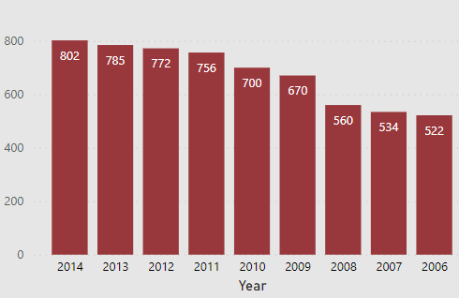
Diagnosis Rates in Different Years
The Increase of Diagnosis Rates of TBI from 2006 to 2014 has been attributed by:
Increased Awareness campaigns and education initiatives
Enhanced medical technology and updated diagnostic criteria
The overall increase in the population
Enhanced data collection methods and comprehensive reporting systems provided more accurate TBI case representation.
Lifestyle changes eg. Increased sports participation, and altered alcohol consumption patterns

Slide 12
02
TBI in Military

Slide 13
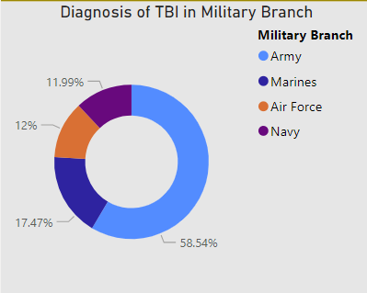
Traumatic Brain Injury in Military
Traumatic brain injury is a significant health issue that affects service members and veterans.
The Army reports the highest rates to likely sustain TBI
The rate of combat-related brain injuries in service members returning from the current conflicts in Iraq and Afghanistan is higher than in previous conflicts.
Blast injuries are a significant cause of TBIs in Military

Slide 14
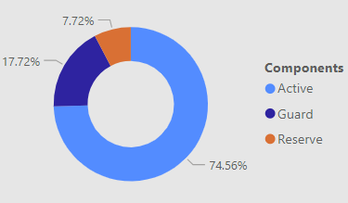
Which military Components are at risk?
Active
Due to its active combat duties and intense training exercises. Soldiers often face direct exposure to combat-related incidents, leading to a higher incidence of TBIs.
74.6%
Guard
Guard members balance civilian life with military duties, facing unique challenges.
17.7%
Reserve
This could be attributed to differences in deployment rates, specialized training, or effective preventive measures implemented within the Reserve.
7.7%

Slide 15
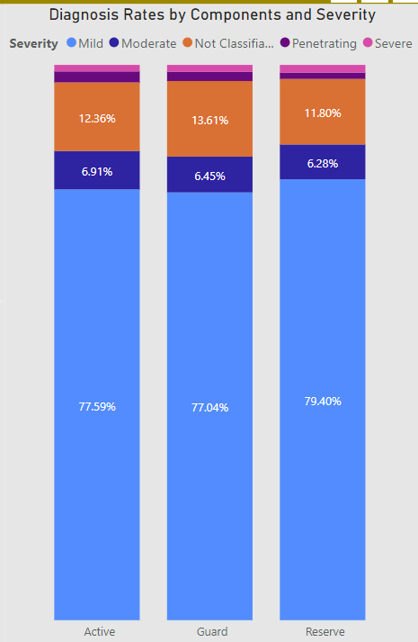
Severity Levels in Different Military Components
Army: Due to its active combat role, the Army might experience a broad range of TBI severities, including mild, moderate, and severe cases. Combat-related incidents and explosives contribute to these injuries.
Guard: Guard members, balancing civilian and military duties, might experience mild to moderate TBIs. Training exercises, domestic emergencies, and deployments can be sources of these injuries.
Reserve: The Reserve component, with a lower incidence of TBIs, might primarily experience mild TBIs due to training exercises and occasional deployments. Severe cases would be relatively rare.

Slide 16
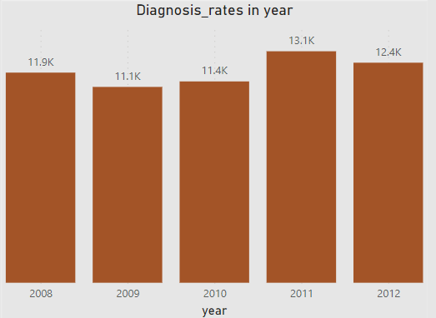
Diagnosis Rates in Different Years
Diagnosis Rates of TBI in Military is fluctuating as compared to the civilians.
This is attributed by:
Varying deployment rates lead to different levels of exposure to combat situations
The nature and intensity of military missions fluctuate yearly
Shifting military operations and engagement in different regions
Fluctuations in training programs and preparedness initiatives influence accident rates

Slide 17
Effective Care and Management of TBI
Early Diagnosis: Prompt evaluation through imaging and neurological assessments is crucial for determining the severity of the injury.
Individualized Treatment: Tailored interventions, including physical, occupational, and speech therapy, address specific symptoms and needs.
Pharmacological Support: Medications manage symptoms such as headaches and seizures, enhancing the patient's overall well-being.
Psychotherapy and Support: Counseling services and support groups assist in addressing emotional and psychological challenges faced by TBI patients.
Rehabilitation: Physical therapy, along with assistive devices, aims to restore motor skills and aid in regaining independence.

Slide 18
Effective Care and Management of TBI
Family and Social Support: Education for families, social reintegration efforts, and long-term monitoring ensure comprehensive care.
Regular Assessments: Ongoing evaluations monitor progress, allowing adjustments to treatment plans for optimal outcomes.

Slide 19
Helmets:
Essential Gear: Stress the importance of wearing helmets in various activities prone to head injuries.
Specific Use: Highlight different helmet types for biking, sports, and motorcycling for tailored protection.
Safety Advocacy:
Bicycle & Sports: Promote consistent helmet use, emphasizing proper fit and compliance with safety rules.
Workplace & Motorcycles: Encourage strict adherence to helmet regulations in workplaces and on motorcycles, emphasizing certified, high-quality helmets.
Awareness Initiatives:
Community Outreach: Organize workshops, school programs, and social media campaigns to educate on TBI risks and prevention.
Role Modeling: Encourage influencers and leaders to wear helmets, leveraging positive peer influence within communities.
Prevention of Traumatic Brain Injury (TBI)

Slide 20
Telemedicine and Remote Monitoring: Enables virtual consultations and wearable devices for continuous patient monitoring.
Neuroimaging and Diagnostics: Utilizes advanced imaging techniques like fMRI, CT scans, and PET scans for accurate diagnosis and monitoring brain abnormalities.
Cognitive Rehabilitation Apps: Offers brain training games and speech therapy apps to enhance memory, attention, and communication skills.
Assistive Technologies: Includes smart home devices and Brain-Computer Interfaces (BCIs) for improved independence and communication among TBI patients.
Virtual Reality (VR) Therapy: Utilizes VR simulations for exposure therapy and motor rehabilitation, aiding in emotional and physical recovery.
Predictive Analytics and AI: Employs AI algorithms for data analysis, predicting recovery paths and enabling early detection of complications.
Continued Advancements: Ongoing research and innovation promise refined technologies, shaping the future of TBI management and care.
Transformative Technologies in TBI Management

Slide 21
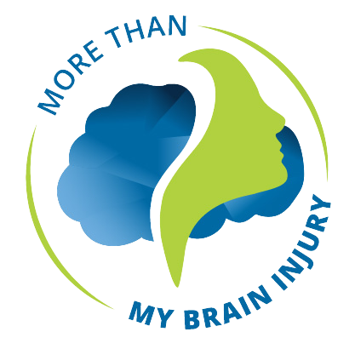
In-Depth Research: Accessing the most recent studies and publications to ensure the information provided is up-to-date and accurate, especially in rapidly evolving fields like medical technology and treatments.
Localization: Adapting the content to different regions or countries, considering regional variations in TBI prevalence, treatments, and preventive measures.
Regular Updates: Establishing a system for regular updates to keep the content current with the latest research findings, medical advancements, and technological innovations related to TBI.
Enhancements and Future Plans

Slide 22
Protect your head, protect your future.
Thank You

